Slide 1
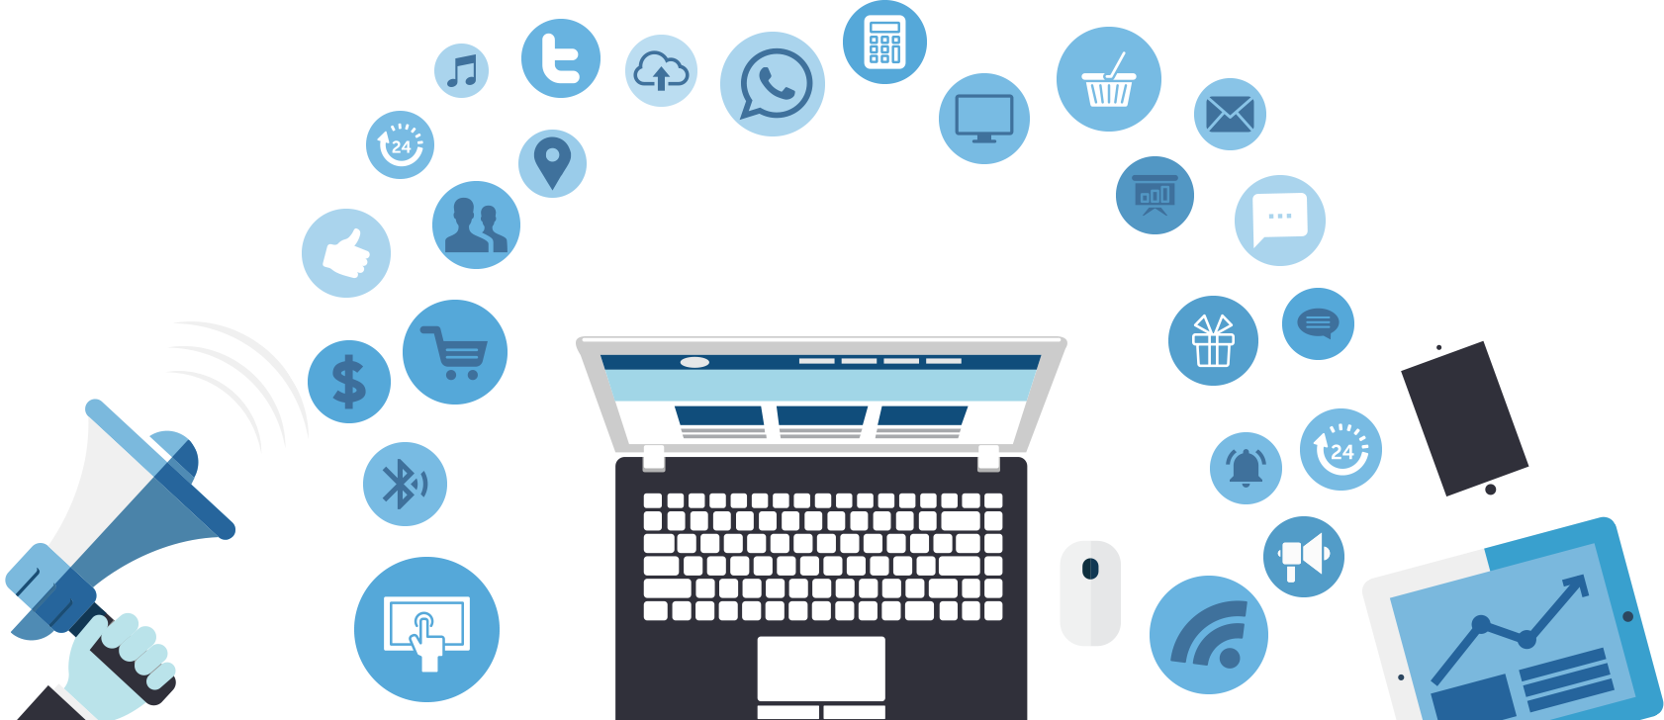
Digital Marketing

Slide 2
Table of Content
Introduction
Why are people going online
What is digital marketing?
Digital Marketing objectives
SEO
PPC
Social Media Marketing
e-mail Marketing
Content Marketing
Analytics

Slide 3
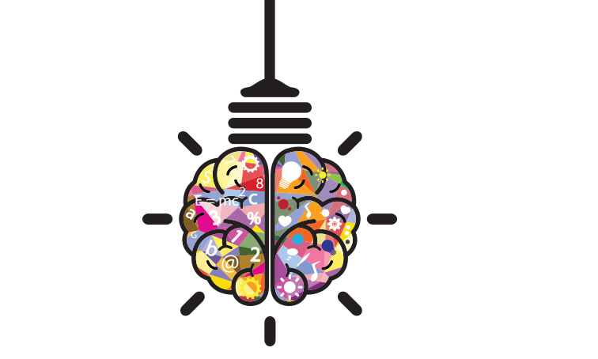
Things to keep in mind:
1-There is no real precondition to this course we expect don’t be shy and interact.
2-The digital world moves very fast and so should you.

Slide 4

Why people go online

Slide 5
For information on a new product, service or location
If they have a question
If they are looking for help
If they want more information on certain individuals or organizations
General information (maybe about you…)
New employees
Available jobs …… etc.

Slide 6
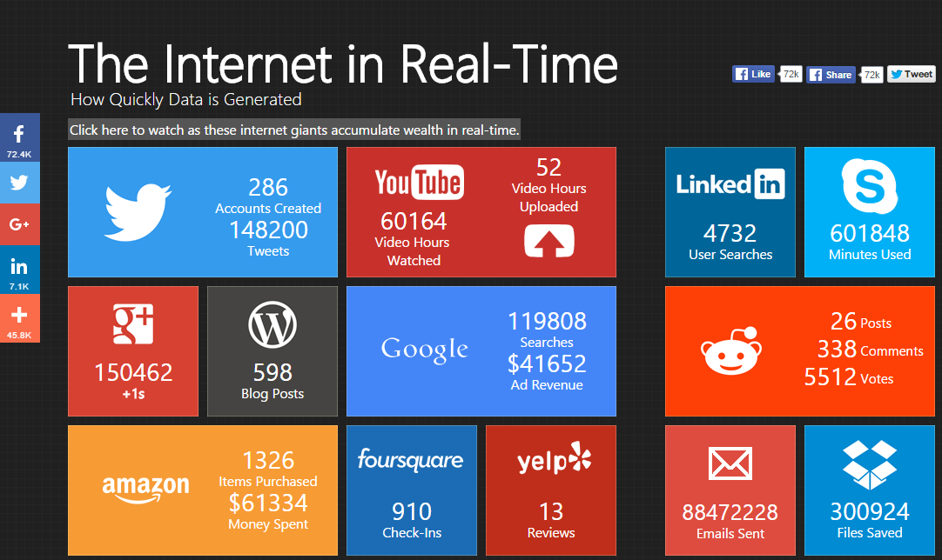
http://pennystocks.la/internet-in-real-time/

Slide 7
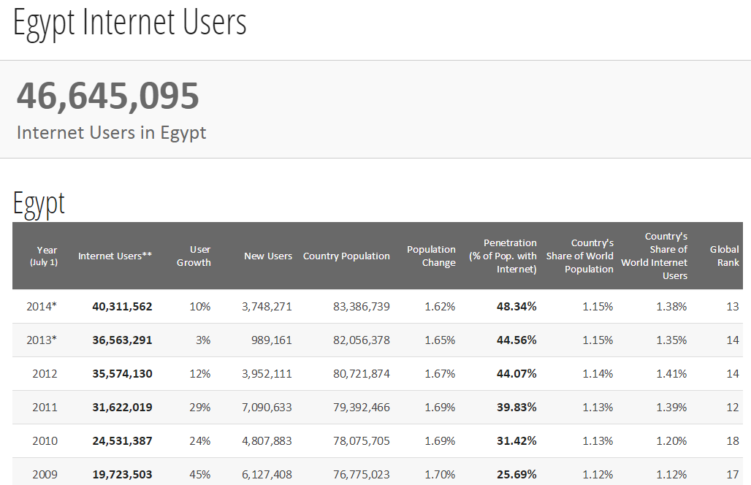
http://www.internetlivestats.com/internet-users/egypt/

Slide 8
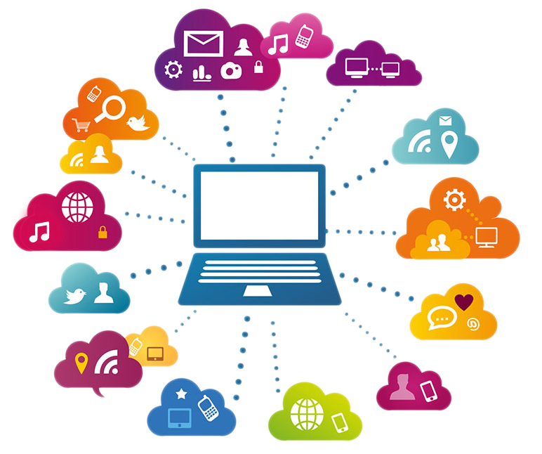
What is digital Marketing?
Digital marketing is a term that refers to various and different promotional techniques deployed to reach customers via digital technologies.
Process of building and maintaining customer relationships through online activities to facilitate the exchange of ideas, products and services.

Slide 9
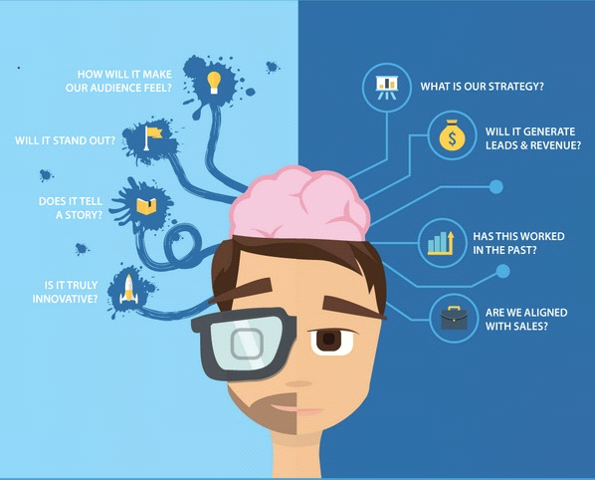
Art & Science

Slide 10
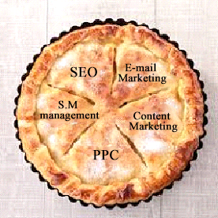
Digital marketing is like a pie
The whole pie is all of your customer and there are different ways to reach them, to get more of the pie you have to reach them all.

Slide 11
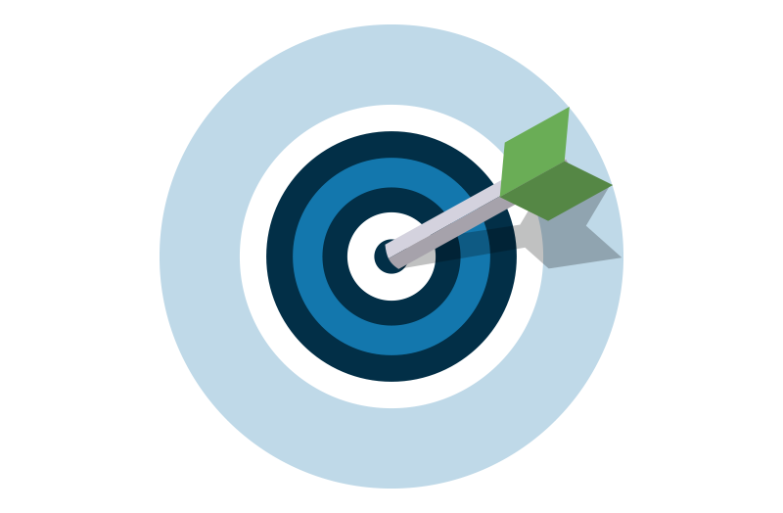
Digital Marketing objectives
Increase brand awareness
Reaching the right audience
To engage with your audience
To motivate your audience to take action
Efficient spending on your campaign
Return on investment (ROI)

Slide 12
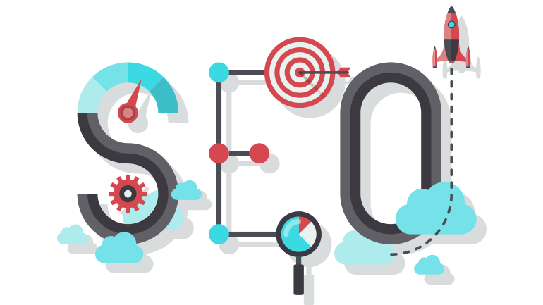
Search engine optimization (SEO)
SEO Is the process of getting traffic from the “free,” “organic or “natural” listings on search engines.
All major search engines such as Google, Yahoo have such results, where web pages and other content such as videos or local listings are shown and ranked based on what the search engine considers most relevant to users.
Payment isn’t involved, as it is with paid search ads.

Slide 13
Advantages of search engine optimization (SEO)
Your website will be found
Expand your customer base and target audience
Free traffic
Targeted traffic
Higher sales
Global reach
All the results can be measured
Better conversion (sales)
Pull marketing

Slide 14
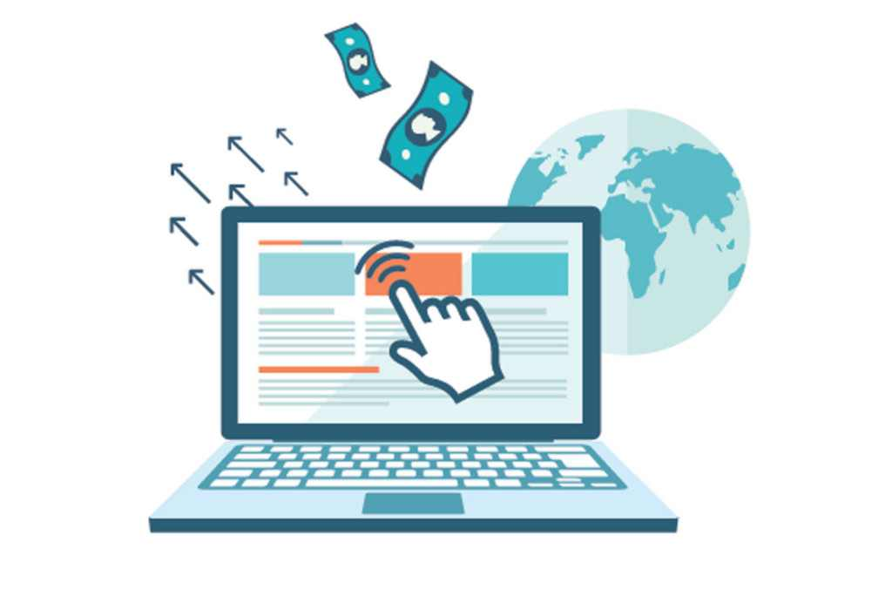
PPC-Pay Per Click
Is an internet advertising model used to direct traffic to websites, in which advertisers pay the publisher when the ad is clicked.
Hence the title, pay per click.
Advertisers place bids on keywords or phrases that they think their target audience would type in a search field when they are looking for specific product or service.
CPI (Cost per impression)

Slide 15
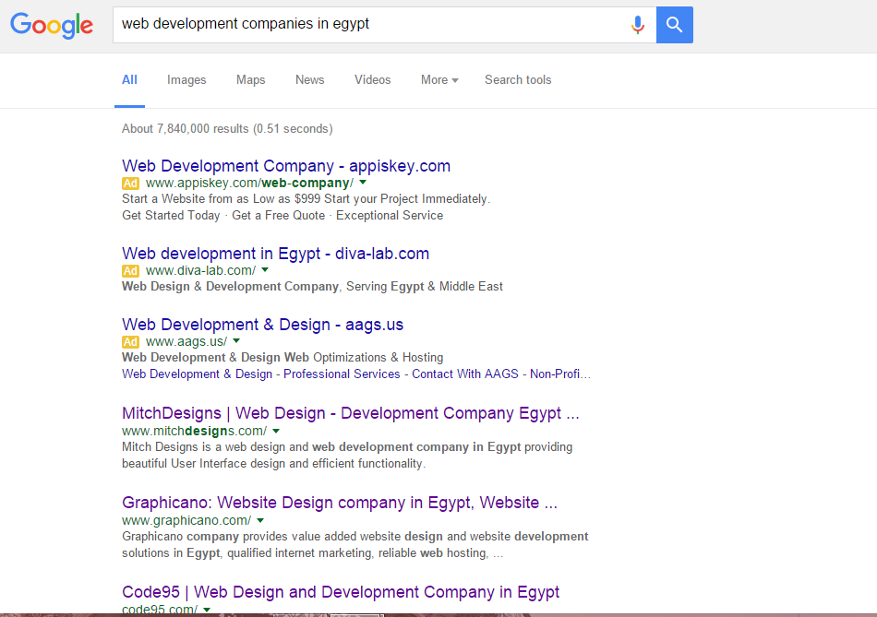

Slide 16
Advantages of pay per click (PPC)
Very fast
Easy implementation
Get targeted visitors
Can yield highly profitable results
Great testing platform and can be highly targeted (PPC analytics )
Time of day
Geographic area
Keywords and phrases

Slide 17
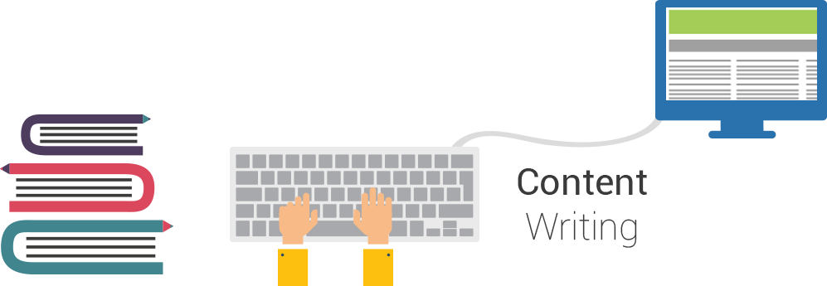
Content Marketing
Content marketing
Is a strategic marketing approach focused on creating and distributing valuable, relevant content to attract and retain a clearly-defined audience and drive profitable customer action.
(Blog-Social media- Articles-Newsletter-Magazines)

Slide 18
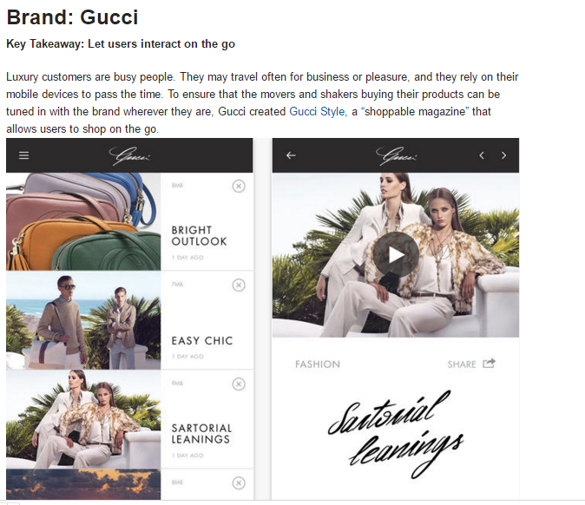
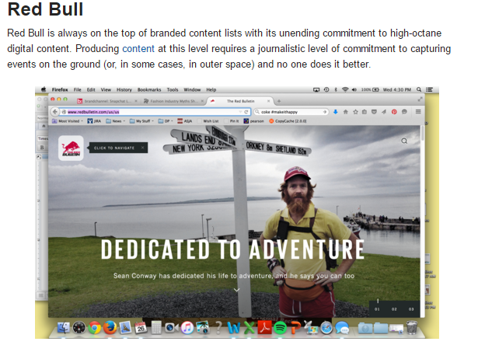

Slide 19


What is UGC ?

Slide 20
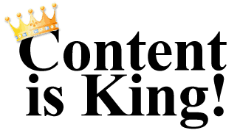
Advantages of content marketing :
Content marketing can enhance your brand image.
Content marketing shows people your human side (SM posts).
Content marketing boosts customer engagement.
Content marketing attracts people with real interest in your brand.
Content marketing works with any industry.
Content marketing helps grow a long-term audience.
Content marketing gives you more control over your message.
Content marketing influences purchasing decisions.
Content marketing improves your social media presence.

Slide 21
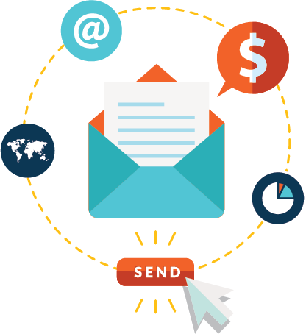
Email Marketing
Email marketing is directly marketing a commercial message to a group of people using email.
Email marketing is the use of email in marketing communications.

Slide 22
What sort of email?
In its broadest sense, the term covers every email you ever send to a customer or potential customer. In general, though, it's used to refer to:
Sending direct promotional emails to try and acquire new customers or persuade existing customers to buy again.
Sending emails designed to encourage customer loyalty and enhance the customer relationship.
Examples of E-mail marketing Software:
Benchmark.
Mailchimp.

Slide 23
Advantages of Mail Marketing:
Great for customer retention.
The best in bringing back visitors.
Super useful for long term Customer Relationship
Perfect for 1 on 1 Marketing
Offers analytics and insights
Offer design templates

Slide 24
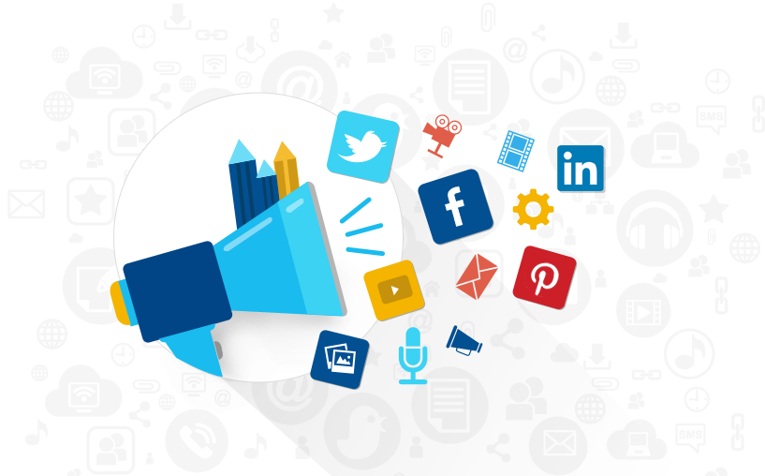
Social media marketing
Social media marketing is marketing using online communities, social networks, blog marketing and more.
Social media is engaging with customers online.
According to Wikipedia, social media is internet-based tools for sharing and
discussing information among human beings.
Any website which allows user to share their content, opinions, views and encourages interaction and community building can be classified as a social media.
Some popular social media sites are: Facebook, YouTube, Twitter, Instgram.

Slide 25
Social media marketing advantages :
Does not require specialization or vast technical skills
Generating exposure to businesses
Increasing traffic/subscribers.
Rise in search engine rankings.
Generating qualified leads due to better lead generation efforts.
Selling more products and services.
Reduction in overall marketing expenses.
Content promotion
Cost effective (only time and effort)

Slide 26
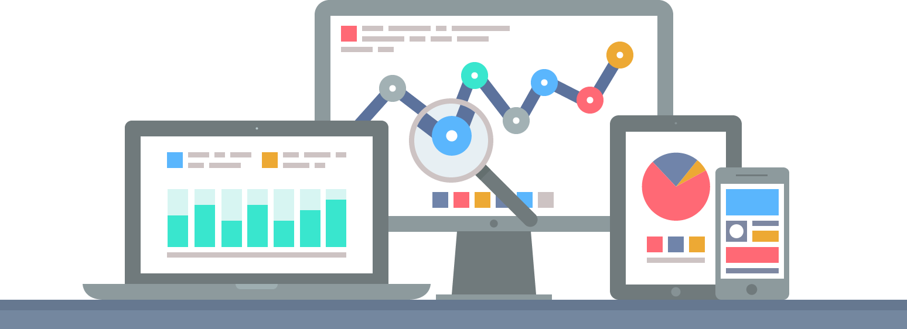
Analytics
Google Analytics is a free Web analytics service that provides statistics and basic analytical tools for search engine optimization (SEO) and marketing purposes. The service is available to anyone with a Google account.

Slide 27
Google Analytics features include:
• Data visualization tools including a dashboard, scorecards and motion charts, which display changes in data over time.
• Segmentation for analysis of subsets, such as conversions.
• Custom reports.
• Integration with other Google products, such as AdWords, Public Data Explorer and Website Optimizer.

Slide 28
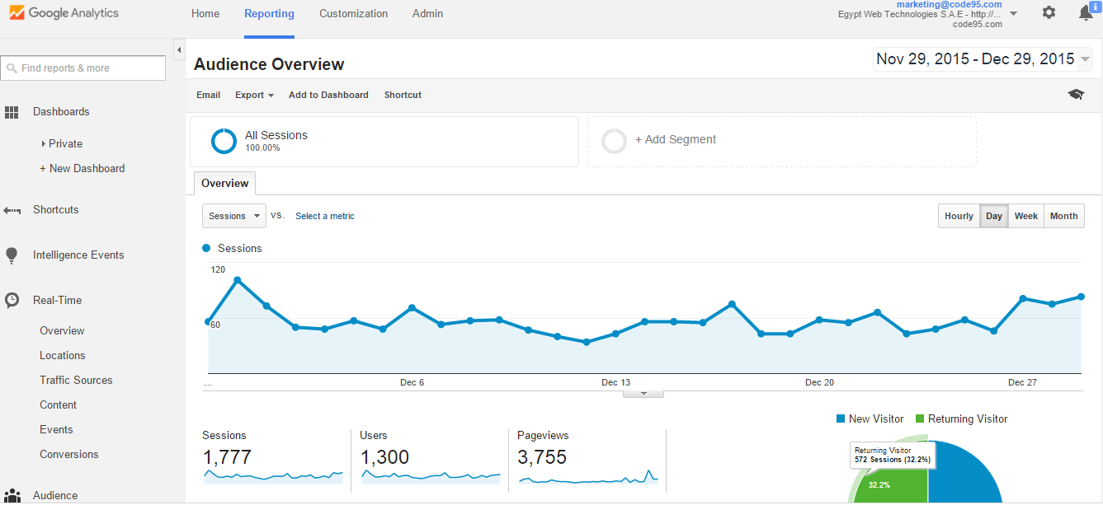

Slide 29
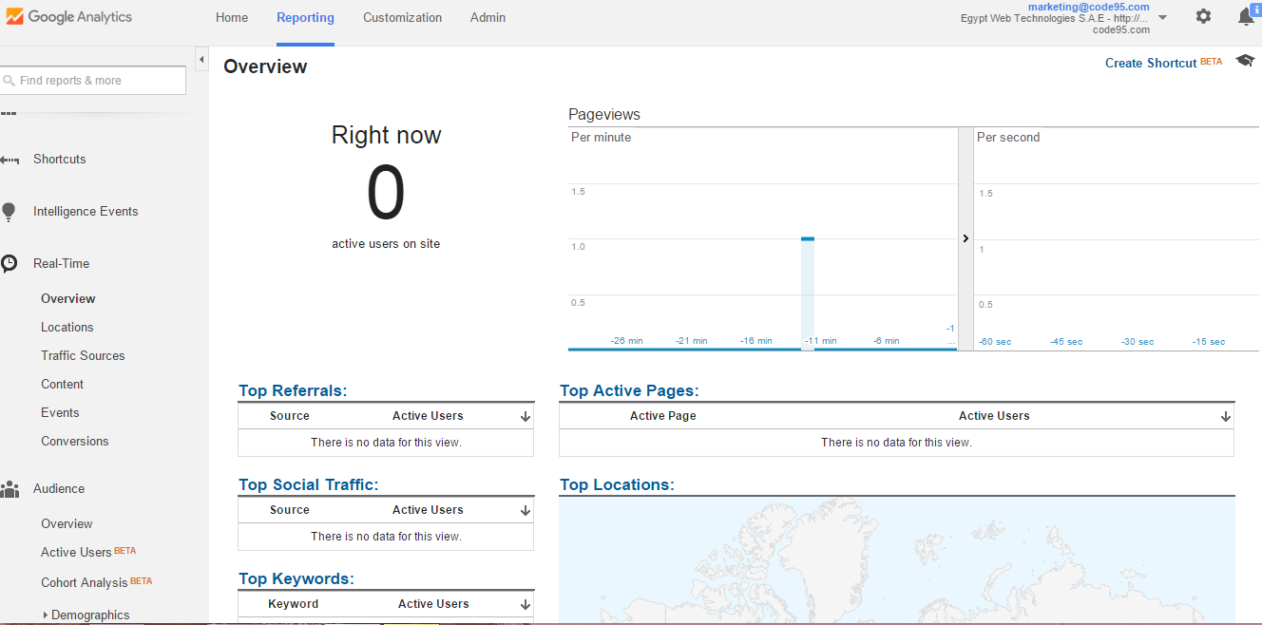

Slide 30
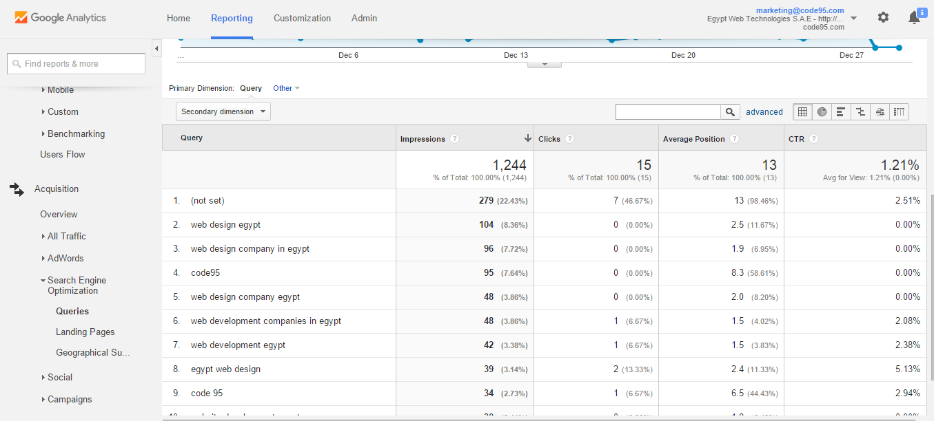

Slide 31
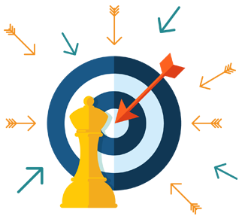
Digital strategy
A digital strategy is a plan to accomplish something with the benefit of digital tools.
Accomplish Something: Objective has to be measurable and actionable
Digital Tools: Social media channels
Why Digital:
Accessible
Flexible and Scalable
Instant Everything is tested
Power of feed back

Slide 32
Blogs to follow
http://contentmarketinginstitute.com/
http://www.marketingprofs.com/
http://blog.hubspot.com/
http://www.socialmediaexaminer.com/
https://blog.bufferapp.com/

Slide 33
Thank You ☺
Yomn Magdy

Slide 34
http://www.internetlivestats.com/internet-users/egypt/
http://pennystocks.la/internet-in-real-time/

